Slide 1
Introducing the new SSD Research and Impact Strategy 2023 - 2028

Slide 2
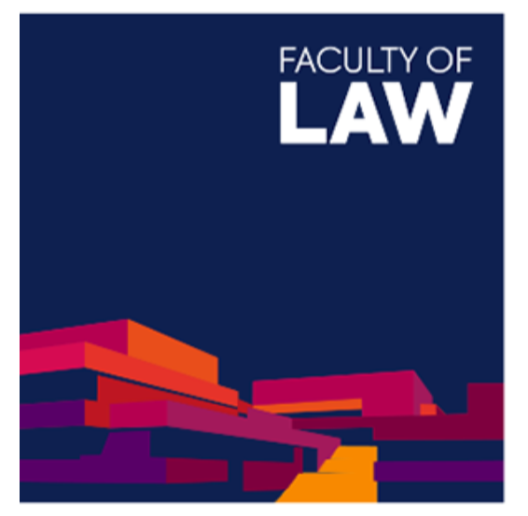
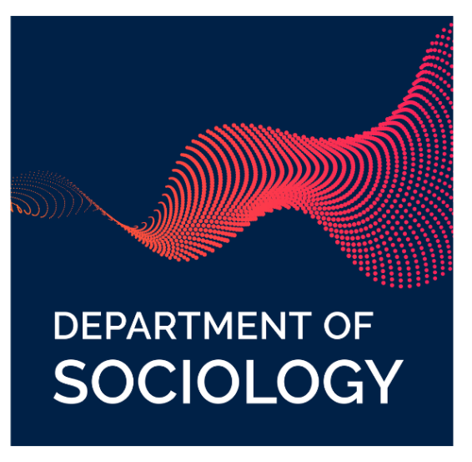
Our strategic aim is to maintain the division’s world leading status in terms of research and impact, demonstrate the value of social science research in addressing global challenges, and enhance and diversify research funding

Slide 3
To achieve this aim, there are five key objectives:
1
To nurture, and help diversify funding for, strategic research activities.
4
To advance integrity, ethics and openness in research and impact.
2
To strengthen engagement and innovation with external partners to enhance research impact.
5
To support departments with strategic research and impact planning.
3
To support researcher career pathways across the spectrum from postgraduates to senior academics.

Slide 4
For more information, visit
https://socsci.web.ox.ac.uk/research-and-impact-strategy-2023-2028

